Slide 1
How does a bill become a law at the national level?

Slide 2
The Legislative Branch makes laws. Therefore, all bills begin in the US Congress!

Slide 3
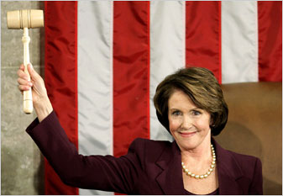
The Speaker of the House is the person in charge of the political party with the most seats in the House of Representatives. Today, the Democrats control the House and Nancy Pelosi is the Speaker
The Senate Majority Leader and President Pro-Tempore of the Senate (The person in charge of the Senate if the Vice President is not present.) Today, the Republicans control the Senate and Mitch McConnell is in charge

Slide 4
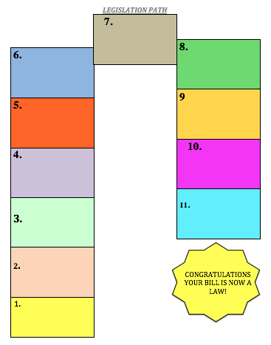
1. A bill is an idea that may or may not become a law.
Sometimes legislators get ideas for bills from citizens or lobbyists.
idea

Slide 5
2. ONLY Members of either the US Senate or the US House of Representatives can propose bills.
Proposal
idea

Slide 6
3. A committee hears bills and recommends changes to them based on the testimony of the public and experts.
Committee
Proposal
idea

Slide 7
A committee is made up 10-45 members of the House of Representatives who craft bills pertaining to a similar subject such as education, defense, transportation, energy, etc.
For example, if a bill was introduced to create a national test for each high school subject the bill would must likely be referred to the Education Committee where it would be debated and altered based on the testimony of experts and the public.
Committee
Proposal
idea

Slide 8
4. Once in committee the bill is generally given to a sub committee.
This is a smaller committee that may have a more specialized and narrow focus.
For instance:
EDUCATION curriculum
Sub-committee
Committee
Proposal
idea

Slide 9
4. In the SENATE there are only 100 members
Therefore, it is not passed on to a sub-committee.
At this point if the bill makes it out of committee then it goes to the full Senate to debate
Sub-committee
Committee
Proposal
idea

Slide 10
5. The Bill is examined and voted on in the sub-committee.
If it passes, it goes back to the original committee.
If it does not pass the Bill DIES
Back to Committee
Sub-committee
Committee
Proposal
idea

Slide 11
Keep in mind -
A Bill can die at any step along the way !
.

Slide 12
6. The committee then meets to prepare a report on the bill. In preparing the report they might recommend that the bill be changed or amended when it is debated on the floor of the House before every member.
Report and change
Back to Committee
Sub-committee
Committee
Proposal
idea

Slide 13
the committee can recommend that the entire House of Representatives debate the advantages and disadvantages of the bill. They also typically send a report explaining why the bill should be passed from the committee’s majority. There may also be a an explanation from the committee’s minority explaining why it should not be passed.
Report and change, recommend
Back to Committee
Sub-committee
Committee
Proposal
idea

Slide 14
7. Once the bill has been marked up it is sent to the Rules Committee who decides the time allotted to debate the bill and other rules regarding the debate of the bill
The Rules Committee
Report and change, recommend
Back to Committee
Sub-committee
Committee
Proposal
idea

Slide 15
8. The Rules Committee then sends the bill before the entire House of Representatives who can decide to pass or reject the bill
The Rules Committee
The Entire House
Report and change, recommend
Back to Committee
Sub-committee
Committee
Proposal
idea

Slide 16
In the Senate there are very few rules. As a result Senators can add many amendments and riders (laws or appropriations having little to do with the actual bill) to the bill. Occasionally Senators are very opposed to a bill and decide to hold up Senate debate by filibustering the bill (delaying any action on a bill by talking a bill to death- the longest filibuster
Riders, Ammendments,
Fillibuster
Back to Senate for Debate
Committee
Proposal
idea

Slide 17
If the bill passes through the Senate in the same form as it was passed in the House of Representatives it goes to the President who can either sign it or veto it.
The Rules Committee
Report and change, recommend
Back to Committee
The
House
The
SENATE
PRESIDENT:
SIGN OR VETO
Sub-committee
Committee
Proposal
idea

Slide 18
f the bill passes, but in a different form from the House of Representatives it goes to a Conference Committee where the house and the Senate fix the differences
The Rules Committee
Report and change, recommend
Back to Committee
The
House
The
SENATE
CONFERENCE
COMMITTEE
Sub-committee
Committee
Proposal
idea

Slide 19
The bill is then sent to the President for a signature or veto
The Rules Committee
Report and change, recommend
Back to Committee
The
House
The
SENATE
CONFERENCE
COMMITTEE
Sub-committee
Committee
Proposal
idea

Slide 20
Proposal
idea

Slide 21
2. ONLY Members of either the US Senate or the US House of Representatives can propose bills. Sometimes legislators get ideas for bills from citizens or lobbyists.
Proposal
idea

Slide 22
2. ONLY Members of either the US Senate or the US House of Representatives can propose bills. Sometimes legislators get ideas for bills from citizens or lobbyists.
Proposal
idea

Slide 23
2. ONLY Members of either the US Senate or the US House of Representatives can propose bills. Sometimes legislators get ideas for bills from citizens or lobbyists.
Proposal
idea

Slide 24
2. ONLY Members of either the US Senate or the US House of Representatives can propose bills. Sometimes legislators get ideas for bills from citizens or lobbyists.
Proposal
idea

Slide 25
2. ONLY Members of either the US Senate or the US House of Representatives can propose bills. Sometimes legislators get ideas for bills from citizens or lobbyists.
Proposal
idea

Slide 26
2. ONLY Members of either the US Senate or the US House of Representatives can propose bills. Sometimes legislators get ideas for bills from citizens or lobbyists.
Proposal
idea

Slide 27
2. ONLY Members of either the US Senate or the US House of Representatives can propose bills. Sometimes legislators get ideas for bills from citizens or lobbyists.
Proposal
idea

Slide 28
2. ONLY Members of either the US Senate or the US House of Representatives can propose bills. Sometimes legislators get ideas for bills from citizens or lobbyists.
Proposal
idea

Slide 29
2. ONLY Members of either the US Senate or the US House of Representatives can propose bills. Sometimes legislators get ideas for bills from citizens or lobbyists.
Proposal
idea

Slide 30
2. ONLY Members of either the US Senate or the US House of Representatives can propose bills. Sometimes legislators get ideas for bills from citizens or lobbyists.
Proposal
idea

Slide 41
1.

